Slide 1
Smart Parenting Assistant
Revolutionizing Child Growth Tracking and Care with AI
Team
Ch. Noman Ahmad
Fasi Tahir
2022-CS-91
2022-CS-71

Slide 2

Introduction to Smart Parenting
Parenting toddlers is both fun and challenging.
Rapid growth in early years requires careful monitoring of nutrition, health, and milestones.
Many parents lack the knowledge or time to make well-informed decisions.
AI can simplify parenting by providing accessible and personalized solutions.

Slide 3

Solution
AI-powered application for personalized parenting support.
Eases parental concerns and promotes healthy child development.

Slide 4

Objectives
Growth Tracking
Abnormality Detection
Personalized Diet Recommendations:
Monitor and evaluate child’s growth over time.
Tailored diet and health advice.
Early identification of growth issues.

Slide 5

Project Scope
Focus on children aged 0-5 years.
Track milestones, offer dietary recommendations, and detect abnormalities.
Not a replacement for medical diagnosis or health management.

Slide 6
Key Features
User Registration and Authentication
Child Profile Management
Growth Monitoring
AI-powered Abnormal Growth Detection
AI-powered Personalized Diet Recommendation
Reminder Management

Slide 7

Growth Monitoring
Monitor child’s height, weight, and milestones.
Data visualization through growth graphs.
Helps identify trends and abnormal growth patterns.

Slide 8

Abnormal Growth Detection
Uses data such as height, age, and gender to detect stunting or abnormalities.
Dataset sourced from Kaggle.
Balanced classes using SMOTE for better model performance.
Model used: Random Forest

Slide 9

Methodology
Data Collection: Kaggle dataset.
Feature Engineering: One-hot encoding, label encoding.
Data Balancing: SMOTE to address class imbalance.
Model Evaluation: Compared multiple models for accuracy and recall.

Slide 10
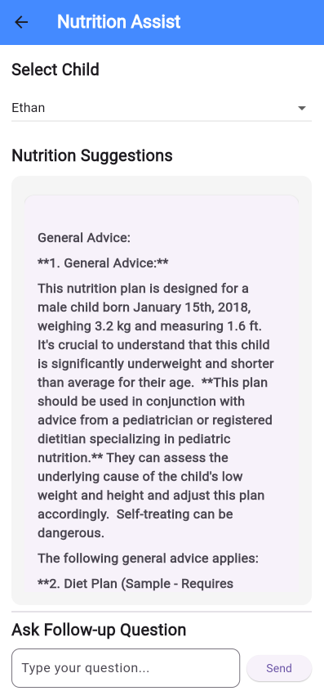
Personalized Recommendations
AI tailors diet plans based on:Growth monitoring.
Child’s age, weight, height.
Allergies and nutritional needs.
Helps parents provide optimal nutrition.

Slide 11
CONCLUSION
Smart Parenting Assistant helps parents make informed decisions.
Reliable, AI-driven tool for growth tracking, diet recommendations, and reminders.
Aligns with WHO standards for child development.
Enhances parenting experience worldwide.

Slide 12


Thanks!
ANY QUESTIONS?

